Slide 1


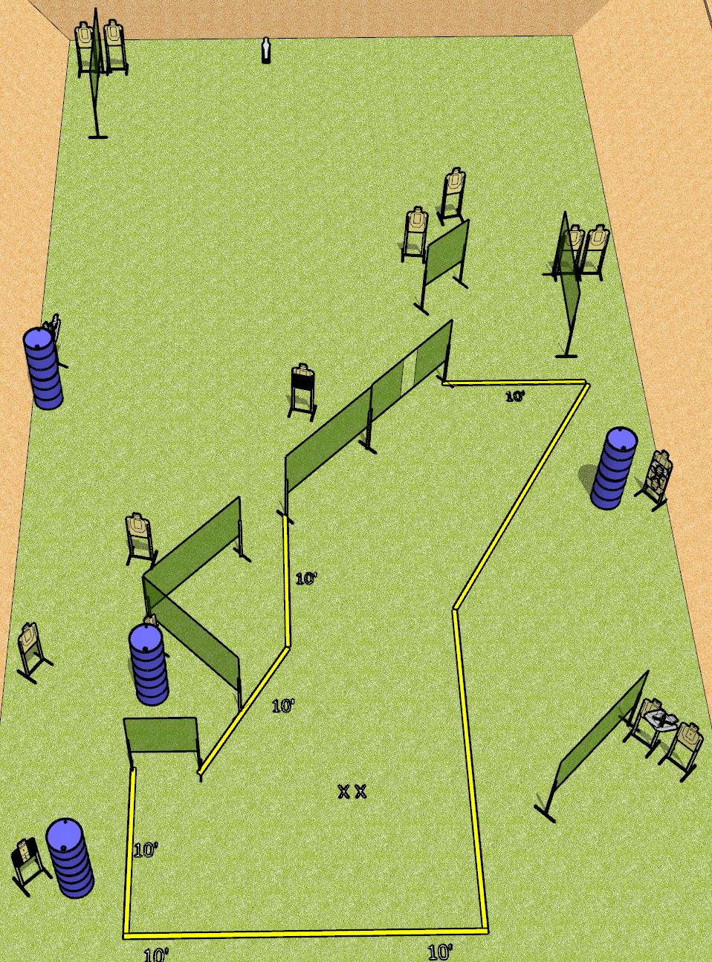
 | Dothan Gun Club – USPSA Match Why Yes, the Entire Bay Course Designer : Drew Coleman
Round Count 33 rounds 16 USPSA 1 mini popper
Equipment List 14 wall feet 1 tux, 1 50%, 17 USPSA (3 NS)

Slide 2
Why Yes, the Entire Bay
Written Stage Briefing
Why Yes, the Entire Bay is a 33 round, 165 point, Comstock course of fire. There are 16 USPSA targets and 1 mini popper. The best 2 hits on paper will score, and steel must fall to score. The start signal is audible.
Handgun start position is feet on X’s, wrists below belt. Handgun is loaded and holstered.
PCC start position is feet on X’s, stock on belt. Loaded carbine is held with both hands, safety on.
On start signal, engage targets as they become available from within the shooting area.

